Slide 1
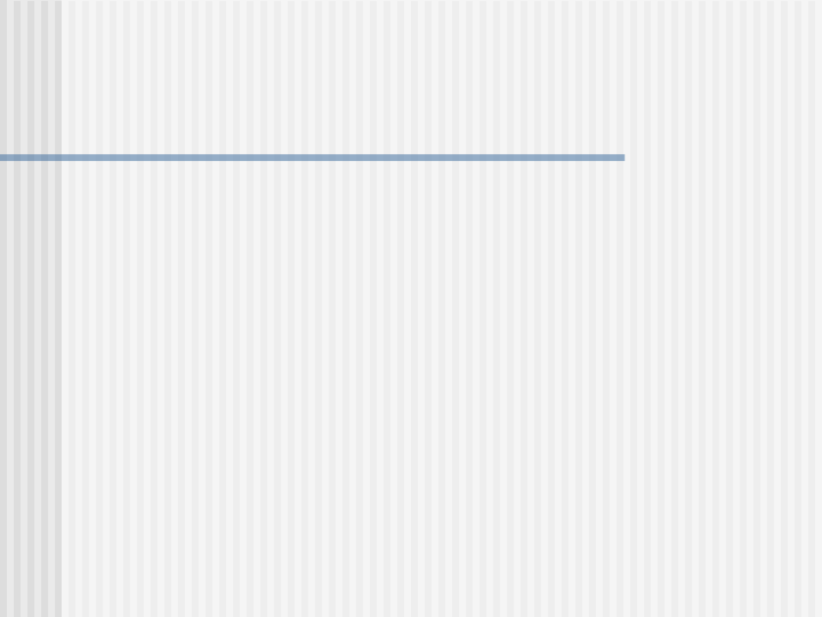
Use Case Modeling
Scenarios, Actors and Use cases
Use case Relationships <<include>> and <<extend>>
Use case Generalization
Writing use cases formally
Choosing System Boundary
Finding Actors and Use cases
Using use cases for testing
Use-Case Realization

Slide 2
Scenario
Scenario- A sequence of steps describing an interaction between a user and a system.
E.g. Operation of an ATM card machine (All goes well scenario)
The customer inserts a card in the machine. The machine prompts him for a pin. The customer enters the pin. The machine authenticates the pin, displays the balance and asks the user to enter the amount that he wants to withdraw. After the user enters the amount, the machine verifies that the amount is less than Rs. 500 less than the amount present in the savings account of the customer. It then generates the cash and displays the balance in the savings account. The customer ends the transaction and the machine outputs the card.

Slide 3
Alternate Scenarios (1 & 2)
1. When the customer types the pin, the system outputs that the pin is invalid and asks the user to try again. This goes on two more times and if the pin is incorrect each time, the machine ends the transaction and outputs the card to the customer. If the pin was correct at any of the three attempts, then the all goes well scenario would have ensued.
2.The machine was informed that the inserted card was stolen. It removes the card and ends the transaction.

Slide 4
Alternate Scenario (3)
3. If after the successful validation of the pin the user enters an amount not less than Rs. 500 less than or equal to the amount in the savings account. The machine outputs a warning about the fine that the customer would have to pay if his balance would become less than Rs. 500 and asks him if he still wants to continue. If the user consents than the machine outputs the cash, displays the balance in the customer's account, shows him the fine that he has to pay within one month to the bank. The customer ends the transaction and the machine outputs the card back to him.

Slide 5
Alternate Scenario (4)
4. After the pin validation, the customer enters an amount greater than the amount in his savings account. The machine outputs the message and asks the user to re-enter. If he re-enters the correct amount then the successful scenario will ensue else if he enters amount less than or equal to the amount in his savings account but not less than Rs. 500 less than the amount in his savings account, then case 3 will occur. If he persists in entering an amount greater than the amount in his savings account, the machine will give him two more opportunities and then output the card and end the transaction.

Slide 6
Use Case
Use Case-A collection of successful and unsuccessful scenarios that describe users using a system to support their goal.
First scenario was “Everything goes well” scenario and “persistently inputting invalid password using a stolen card, “persistently inputting an amount greater than amount in the savings account” were examples of unsuccessful scenarios.

Slide 7
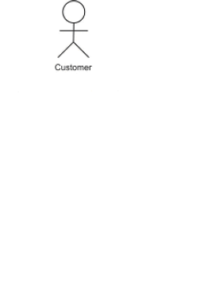
Actor
An actor is a role than a user plays with respect to the system.
E.g.s.Customer, the manager of the local branch where the machine is located, the regional security manager

Slide 8

Representation of a non-human Actor

Slide 9
The include relationship
Used to depict similar behaviour across several use-cases without the description of that behaviour being replicated.
Akin to that of a function or a macro in programming languages.
Suppose a use case “A” includes another use case “B”. At the point in A where B is included, control will be transferred the steps listed for B and after the steps in B are carried are carried out; control is transferred back to the main use case A. Suppose other use cases “C” and “D” want to include the use case D, they can do so. The use case B is written only once and used multiple times by different use cases.

Slide 10
The include relationship
Supports reuse.
Don’t use include relationship if an included use case describes behaviour which cannot be used by more than one use cases.
E.g. In a VIDEO library management system, there are two options: either rent a DVD or buy a DVD. For both these options the customer can pay by using a credit card. So, both use cases “Process Rental Request” and “Process Sale Request” can include “Handle Credit card Payment” use case instead of writing it twice.

Slide 11
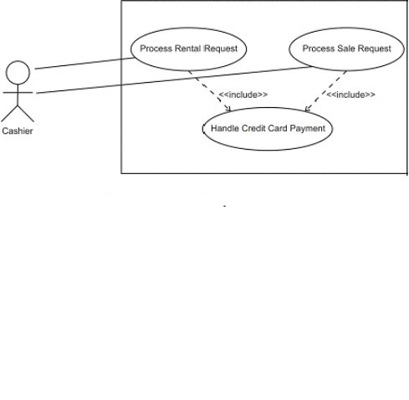
The include relationship

Slide 12
The extend relationship
Used to depict some additional functionality required of a use case by putting the description of the additional functionality in another use case and letting this new use case extend the original use case.
Denoted by a dashed arrow with <<extend>> stereotype. The base of the arrow points towards the extending use case and the arrowhead points to the extended use case.

Slide 13
Example
Consider an IT Company that gives part of the developer's salary as gift vouchers to be redeemed at specific supermarkets only. When the use cases for the Supermarket Management System were written, base-lined and the system built, the mode of payment was cash. Later, when the supermarket signed an agreement with the IT Company, it wanted the system to have a provision to accept payment through redemption of gift vouchers. Suppose that the use case "Process Customer Sale" was written in the following manner:

Slide 14
Example
1) Customer arrives at the Payment Counter with the goods that he intends to buy.
2) Cashier starts a new transaction on the system.
3) Cashier repeats steps 3 and 4 till all the goods submitted by the customer are over.
4) Cashier submits the bar code of the item to the system with the aid of a bar code scanner.
5) System reads the item's description and its price
6) System displays total amount.
7) Cashier communicates total to the customer and asks for payment.
8) Customer pays the required amount through cash.
9) Cashier commands system to generate receipt.
10) System logs the transaction and generates the receipt.
11) Customer leaves with his goods and the receipt.

Slide 15
Example
Suppose that this use case is an artifact and hence cannot be modified.
Aim is to add the extra behaviour without changing the original use case.
Use "extend" relationship
Write another use case, "Handle voucher redemption" which describes the sequence of steps when the employee of the IT company wants to purchase goods through voucher redemption.
This use case is the extending use case.
Clearly specify the point at which the extending use case extends the base use case and the condition under which it does so.

Slide 16
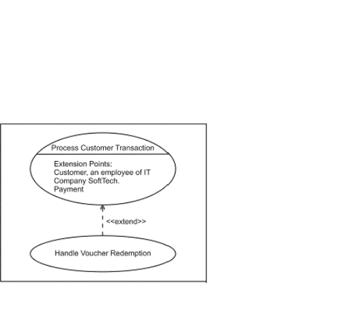
Example

Slide 17
Example
Extension points in Base use case:
Customer an employee of IT Company SoftTech: Step-I
Payment: Step 7.
Use Case: Handle Voucher Redemption
Trigger: Customer wants to pay with supermarket's vouchers.
Extension Point: Payment in "Process Customer Sale"
Level: Subfunction
Main Success Scenario:
1) Customer gives the vouchers to the cashier.
2) Cashier validates the vouchers and enters the voucher id.
……..

Slide 18
Use Case Generalization
A relationship between a base use case and a derived use case that specifies how a derived use case specializes the features that it inherits from the base use case.
Both base and derived use cases enjoy the same relationship with the actor.
However, the derived use case simply does not use the features that it inherits but modifies them in some manner.

Slide 19
Example
Consider a geometric package which draws polygons of various shapes and sizes. Suppose there is a use case that describes the sequence of steps to draw a polygon.
Use cases "Draw Square" and "Draw Triangle" inherit from this use case and specialize the behavior to draw squares and triangles. The use cases "Draw Triangle" and "Draw Rectangle" enjoy the same relationship with the Mathematician as the use case "Draw Polygon".

Slide 20
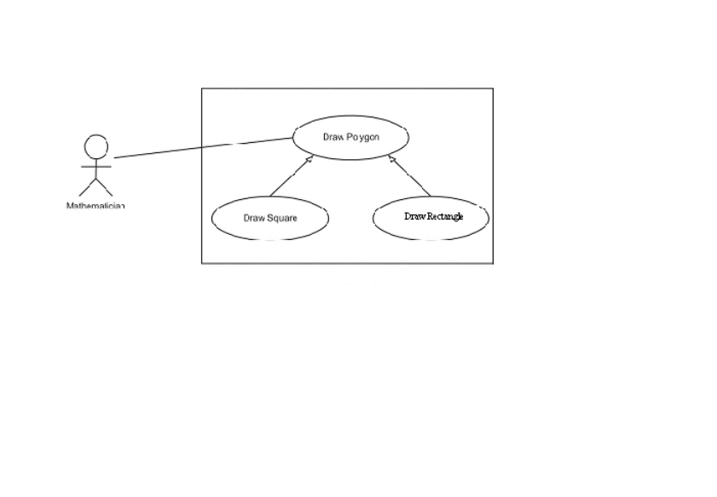
Example

Slide 21
Writing Use Cases Formally
1. Primary Actor: The principle actor who will initiate the use case.
2. Stakeholders and Interests: People and even entities who are interested in the system.
3. Pre and Post-Conditions: A Pre-condition describes something which must always be true before beginning a scenario in a use case. It is not tested within the use case.

Slide 22
Writing Use Cases Formally
Post condition is a condition that must be true at
the successful completion of the use case
4. Main Success Scenario: It is the “everything goes well” scenario. The actor successfully fulfills his goal by interacting with the system.
5. Alternate Flow: They are the other scenarios described.

Slide 23
Writing Use Cases Formally
6.Special Requirements: Here, non-functional requirements or any constraints relating to the use case may be recorded.
7.Technology and Data Variations List: In this section, any variation in the method to perform a task is recorded.

Slide 24
A Note about Actors
Actors are of three types Primary, Supporting and off-stage. The Primary actor is the one who fulfils his goal with the help of the system.
The Supporting actor provides some service to the system.
The Off-stage actor is interested in the behaviour of the use case but does not fall in the above two categories.

Slide 25
How to Choose the System Boundary?
When we design an ATM system, other than the ATM, everything else is outside its boundary.
The Bank's Branch Manager, the Security Manager, the Customer are outside its boundary.
To identify the boundary, the questions asked can be "Should the system we are designing validate the customer's card? No. So let there be a separate system for this purpose.

Slide 26
How to Choose the System Boundary?
Is it the ATM's duty to generate and print its own money? No. So it’s the local branch manager's job to authorize the amount of money for a particular machine and see that it remains equipped to deal with the customers. So a decision on what lies outside must be reached so as to automatically get an idea of the boundary.

Slide 27
Finding Actors
Any system is built to perform certain functions.
Who benefits from the system's functionality?
Who provides functionality to this system?
Whose job is it to keep the system in a working condition?”
Who will manage and secure the system?“
Will the system interact with any other system/ hardware?
Will it take services from or give services to any other system?

Slide 28
Finding Use Cases
Identify the goals of the primary actors
Use a verb to note the starting name of the use case like "Withdraw Cash", "Secure ATM machine" etc.

Slide 29
Use of Use cases for Validation
Validation means testing whether a system has been built that actually meets the requirements of the customer.
The customer may not be IT-savvy
Customer may not know the capabilities of the programming language/platform that the developer intends to use.
Thus the onus falls on the developer to make the customer aware of the capabilities.

Slide 30
Use of Use cases for Validation
Developer must review requirements with the customer to satisfy himself that these are what the customer actually means and wants.
After discussions with the customer, he can adapt the use cases accordingly.
Process involves iterations and frequent reviews and discussions with the customer.
Very important to validate the requirements of the customer in the early stages of software development.

Slide 31
Use of Use cases for Verification
Verification involves determining whether a system has been built according to the requirements specification and design.
Verify by comparing the steps in the use cases and actually executing the system to determine that it behaves in a manner as specified in the use case description.
Verification can take place only after executable parts of the system have been constructed.
Not necessary to prolong verification after the entire system has been built.

Slide 32
Use of Use cases for Verification
If some of architecturally significant, high risk use cases have been realized in code, treat it as a partial system and verify it against the use case descriptions.
Prepare test cases during the analysis and design.
As the system is built,execute these test cases to detect the presence of bugs.

Slide 33
Use of Use cases for Verification
Use cases describe the functional requirements of the system
Use them to prepare the test cases.

Slide 34
Use Case Realization
Realization: A relationship between an element that specifies behaviour and one that provides implementation.
Use cases can be realized by collaboration.
Collaboration describes a set of objects assembled to carry out a certain task and identifies the specific role that objects play.

Slide 35
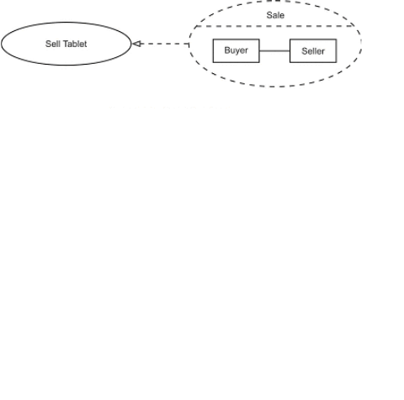
Use Case Realization

Slide 36
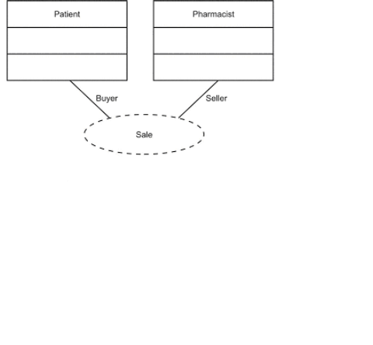
Use Case Realization
Actual classes that occur and the roles they play can be shown with the collaboration icon.

Slide 37
In this use cases example, Credit Card Processing System (Credit Card Payment Gateway) is a subject, i.e. system under design or consideration.
Primary Actor of the system is the Merchant’s Credit Card Processing System.
The merchant submits a credit card transaction request to the credit card payment gateway on behalf of a customer.
Bank which issued customer's credit card is actor which could approve or reject the transaction. If transaction is approved, funds will be transferred to merchant's bank account.
Authorize and Capture use case is the most common type of credit card transaction. The requested amount of money should be first authorized by Customer's Credit Card Bank, and if approved, is further submitted for settlement. During the settlement funds approved for the credit card transaction are deposited into the Merchant's Bank account.
In some cases, only authorization is requested and the transaction will not be sent for settlement. In this case, usually if no further action is taken within some number of days, the authorization expires. Merchants can submit this request if they want to verify the availability of funds on the customer’s credit card, if item is not currently in stock, or if merchant wants to review orders before shipping.
Capture (request to capture funds that were previously authorized) use case describes several scenarios when merchant needs to complete some previously authorized transaction - either submitted through the payment gateway or requested without using the system, e.g. using voice authorization.

Slide 38
Credit use case describes situations when customer should receive a refund for a transaction that was either successfully processed and settled through the system or for some transaction that was not originally submitted through the payment gateway.
Void use case describes cases when it is needed to cancel one or several related transactions that were not yet settled. If possible, the transactions will not be sent for settlement. If the Void transaction fails, the original transaction is likely already settled.
Verify use case describes zero or small amount verification transactions which could also include verification of some client's data such as address.

